Slide 1
How to Develop ?
Ceyhan Çarpa

Slide 2


Slide 3


Slide 4
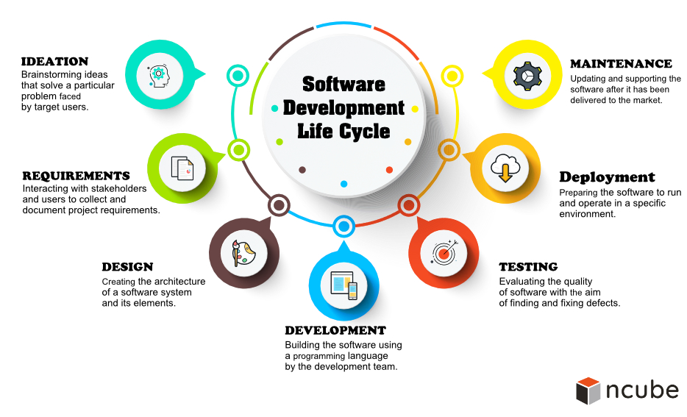

Slide 5
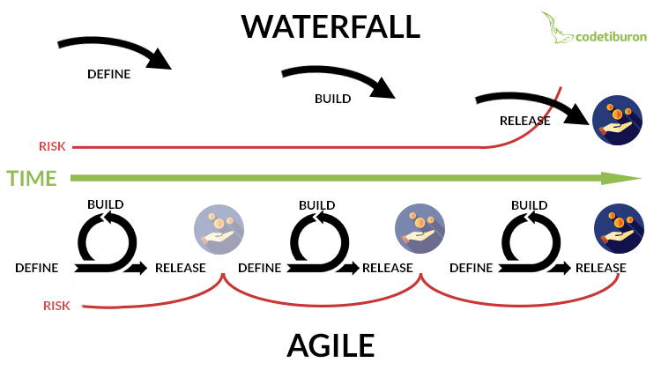

Slide 6


Slide 7
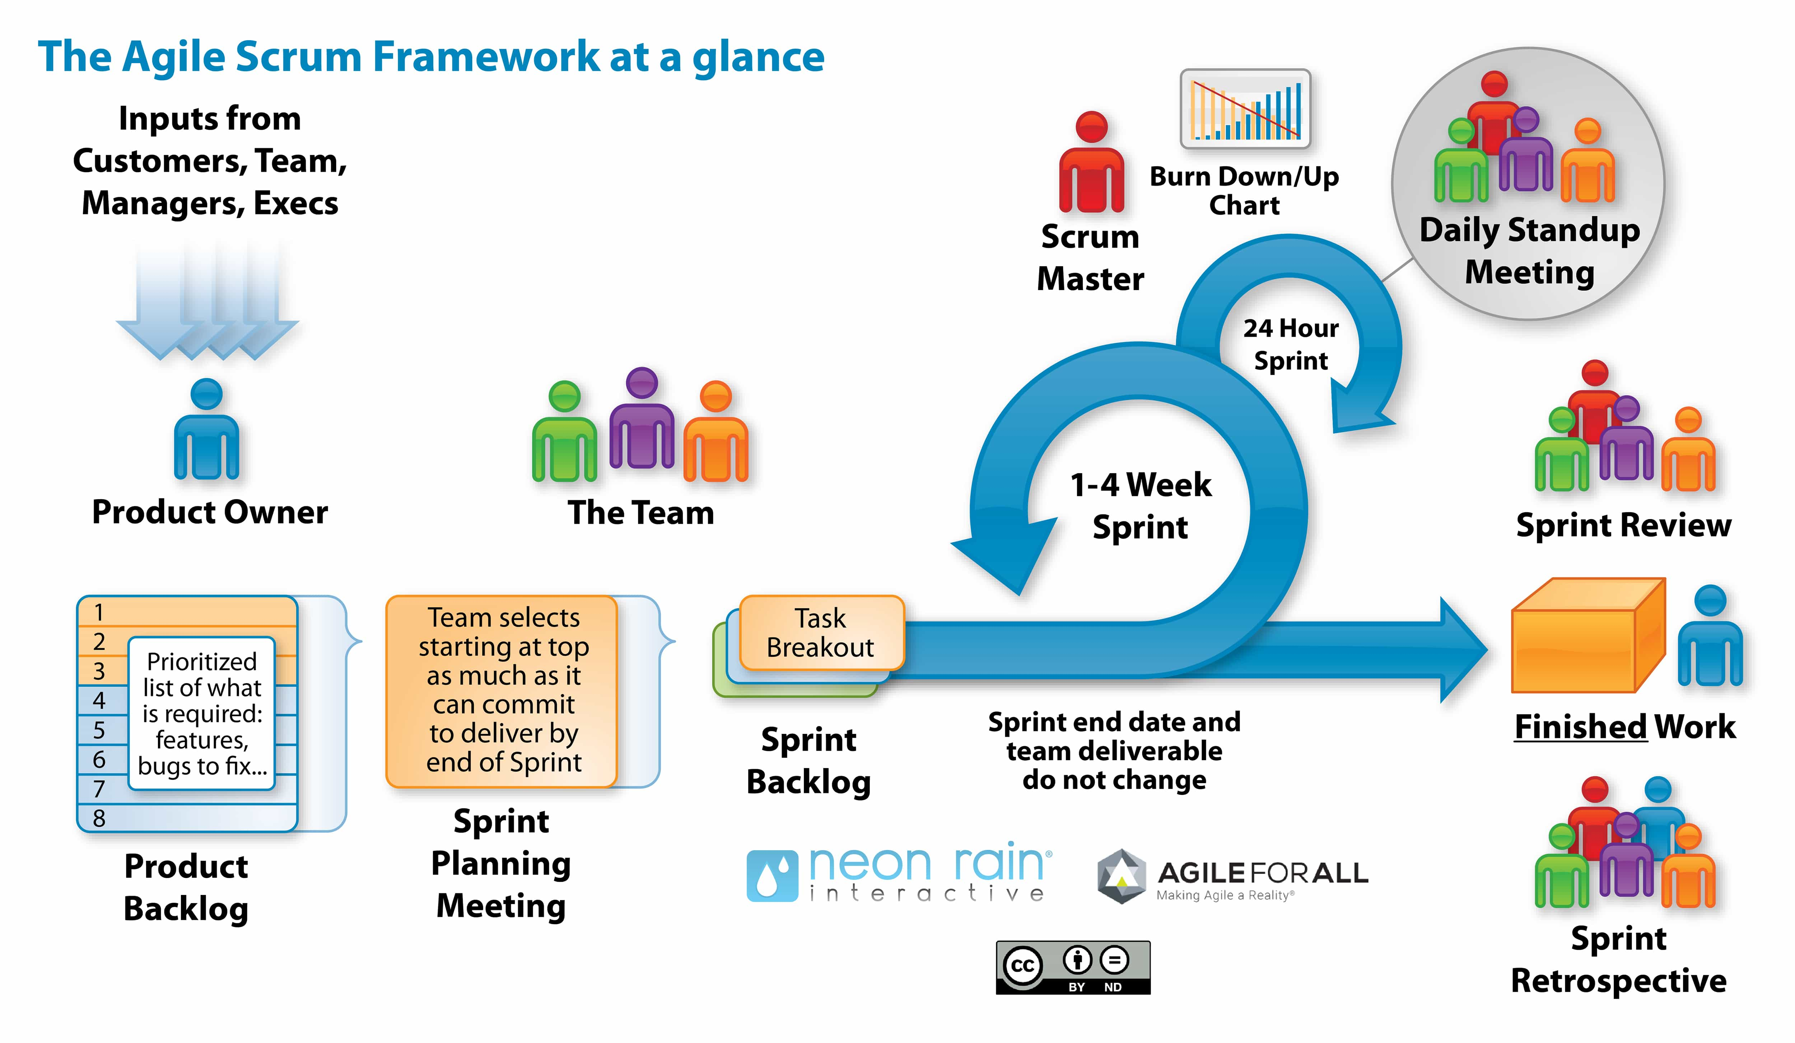

Slide 8


Slide 9
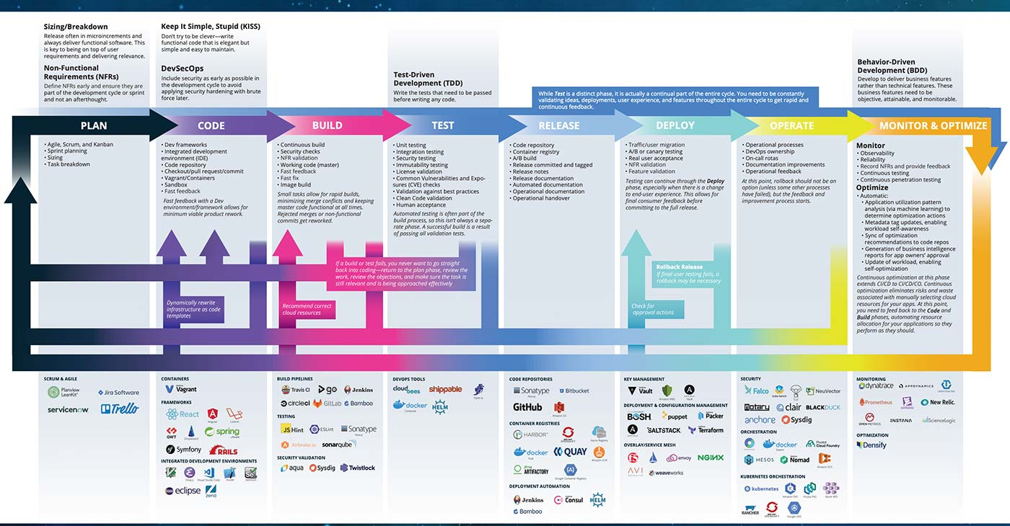

Slide 10



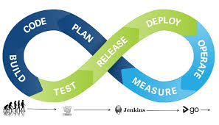

Slide 11


Slide 12


Slide 13


Slide 14
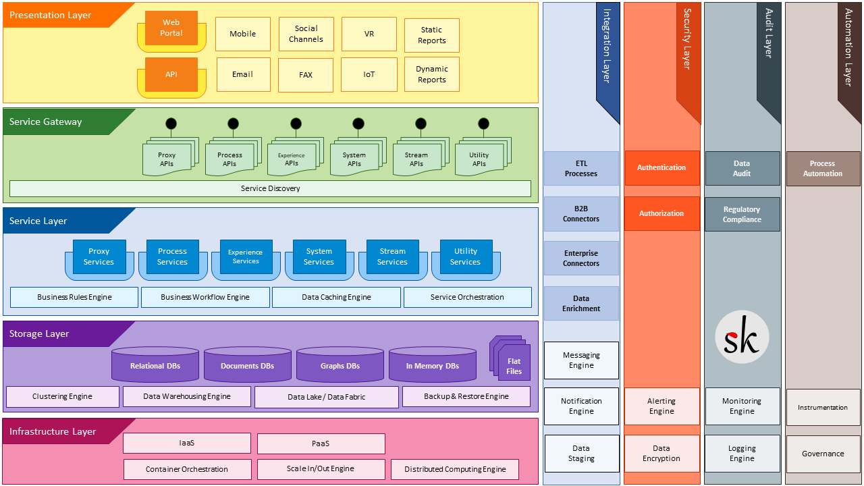

Slide 15
Customer
Sales
Inventory
Financials
Product
Info / Price /
Market Values
PLM
Product Info
MVM
ZCRM
ZBOOKS
D365
Data
Warehouse
Analytics
Product
Market Values
Documentation
Website
HILMAV2
Data
Collector
Information Flow
Timezone
GMT+3
GMT+3
GMT+3
GMT+3
GMT+3
GMT+1
GMT+3
GMT+3
AUS
CHN
IND
RUS
TUR
SWE
EU
DEU-S
US
BRA
GDPR / Data Center
NOR
FIN
POL
DEU-N
ESP
NLD
FRA
CHE
KAM
HRV
Timezone GDPR
EXP
LDAP Gluu
T & I Apps
AWS
Docker
Python/Django
Postgre
Git
SMDEV Apps
Azure
Apache
S3
.MO .PO
CI - CD
Technologies
Globe
API Config Manager
OAUTH2.0
Log Manager
Queue Manager
MVM
User Voice
Production
Data
Collector
SMDEV Applications

Slide 16
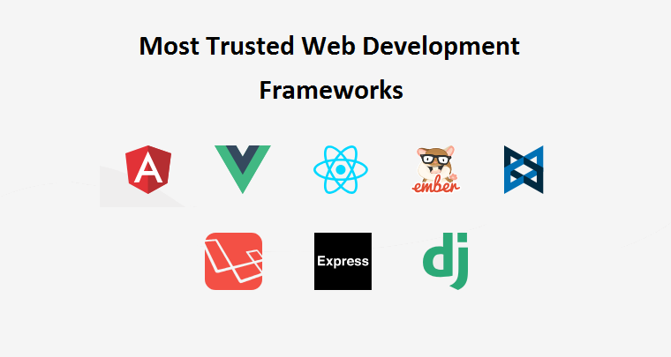


Slide 17


Slide 18
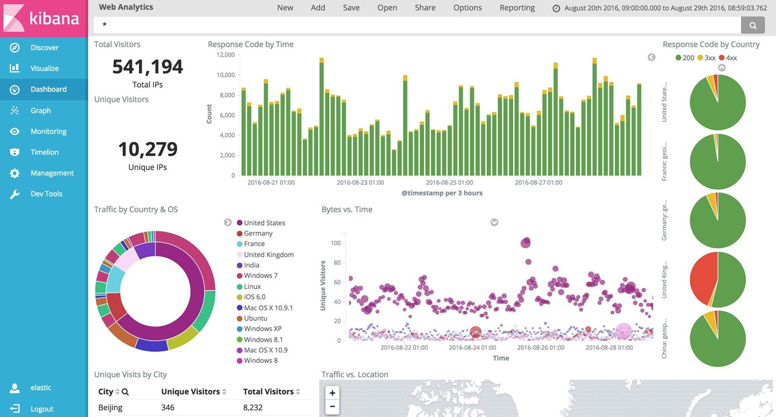

Slide 19
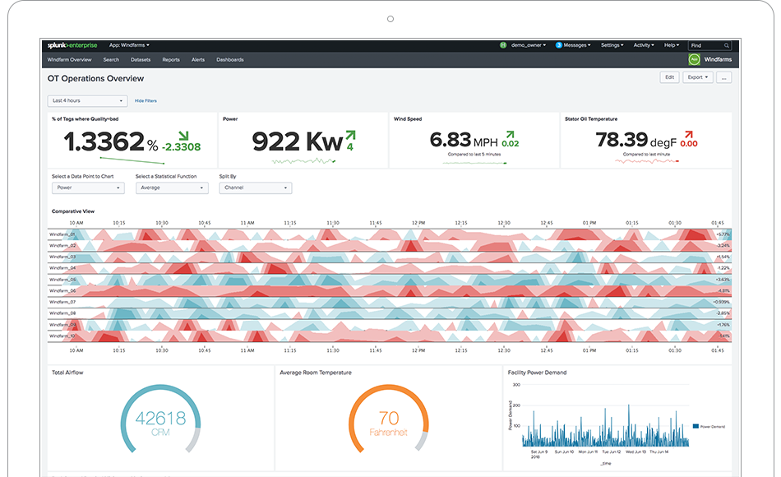

Slide 20
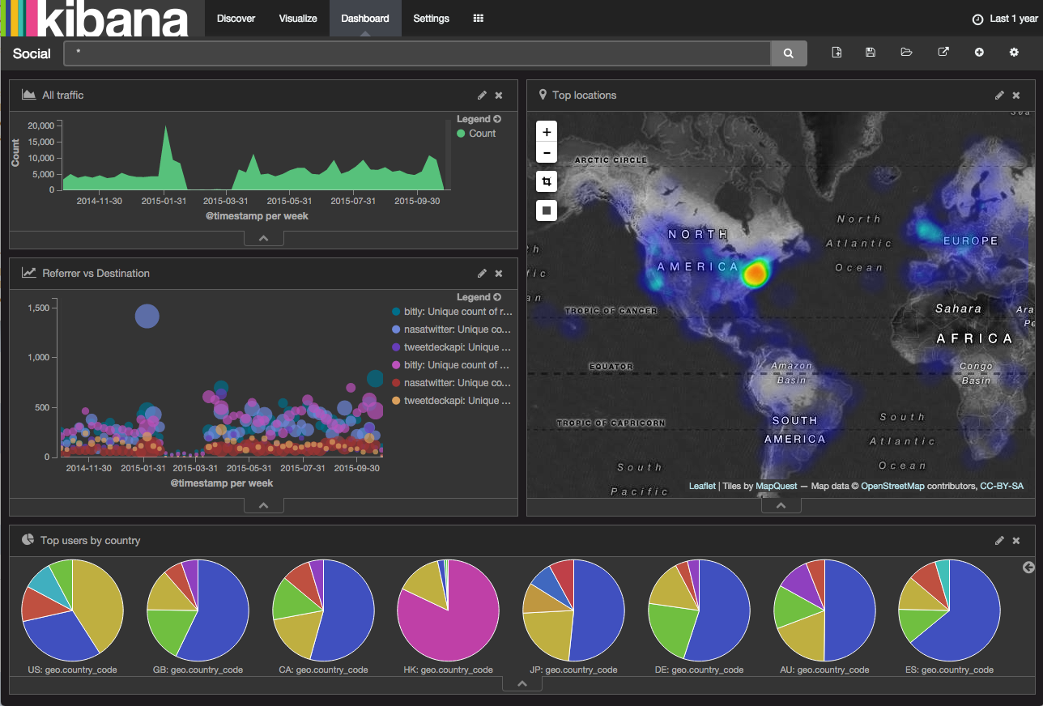

Slide 21
